Slide 1
Socket Programmimg

Slide 2
Socket programming is a way of connecting two nodes on a network to communicate with each other.
One socket(node) listens on a particular port at an IP, while other socket reaches out to the other to form a connection.
Server forms the listener socket while client reaches out to the server.

Slide 3
Java Socket programming
Used for communication between the applications running on different machines.
Socket and ServerSocket classes are used for connection-oriented socket programming.
Client must know two information:
IP Address of Server
Port number

Slide 4
The Socket class is used at the client side to communicate between client and server.
We can read and write message.
2. The ServerSocket class is used at server-side.
The accept() method of ServerSocket class blocks the console until the client is connected.
After the successful connection of client, it returns the instance of Socket at server-side.

Slide 5
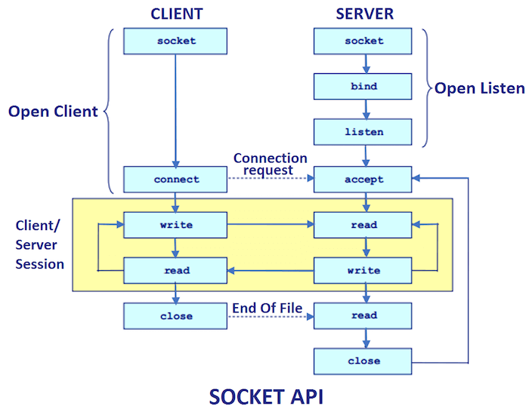

Slide 6
Socket class-CLIENT SIDE
A socket is simply an endpoint for communications between the machines.
The Socket class can be used to create a socket.
Method | Description
1) public InputStream getInputStream() | returns the InputStream attached with this socket.
2) public OutputStream getOutputStream() | returns the OutputStream attached with this socket.
3) public synchronized void close() | closes this socket

Slide 7
ServerSocket class-SERVER SIDE
The ServerSocket class can be used to create a server socket.
This object is used to establish communication with the clients.
Method | Description
1) public Socket accept() | returns the socket and establish a connection between server and client.
2) public synchronized void close() | closes the server socket.

Slide 8
Creating Server
ServerSocket ss=new ServerSocket(6666);
Socket s=ss.accept();//establishes connection and waits for the client

Slide 9
Creating Client
Socket s=new Socket("localhost",6666);

Slide 10
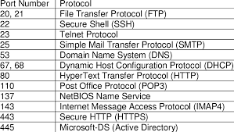

Slide 11
MyServer.java
import java.io.*;
import java.net.*;
public class MyServer {
public static void main(String[] args){
try{
ServerSocket ss=new ServerSocket(6666);
Socket s=ss.accept();//establishes connection
DataInputStream dis=new DataInputStream(s.getInputStream());
String str=(String)dis.readUTF();
System.out.println("message= "+str);
ss.close();
}catch(Exception e){System.out.println(e);}
}
}

Slide 12
MyClient.java
import java.io.*;
import java.net.*;
public class MyClient {
public static void main(String[] args) {
try{
Socket s=new Socket("localhost",6666);
DataOutputStream dout=new DataOutputStream(s.getOutputStream());
dout.writeUTF("Hello Server");
dout.flush();
dout.close();
s.close();
}catch(Exception e){System.out.println(e);}
}
}

